Slide 1
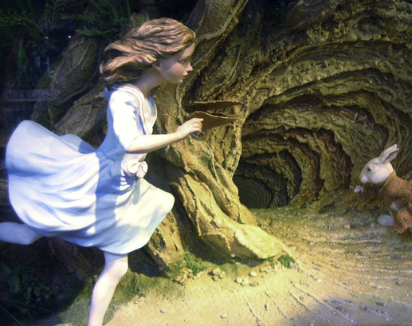
First steps on your R journey
R, Rstudio, Libraries and the Tidyverse

Slide 2
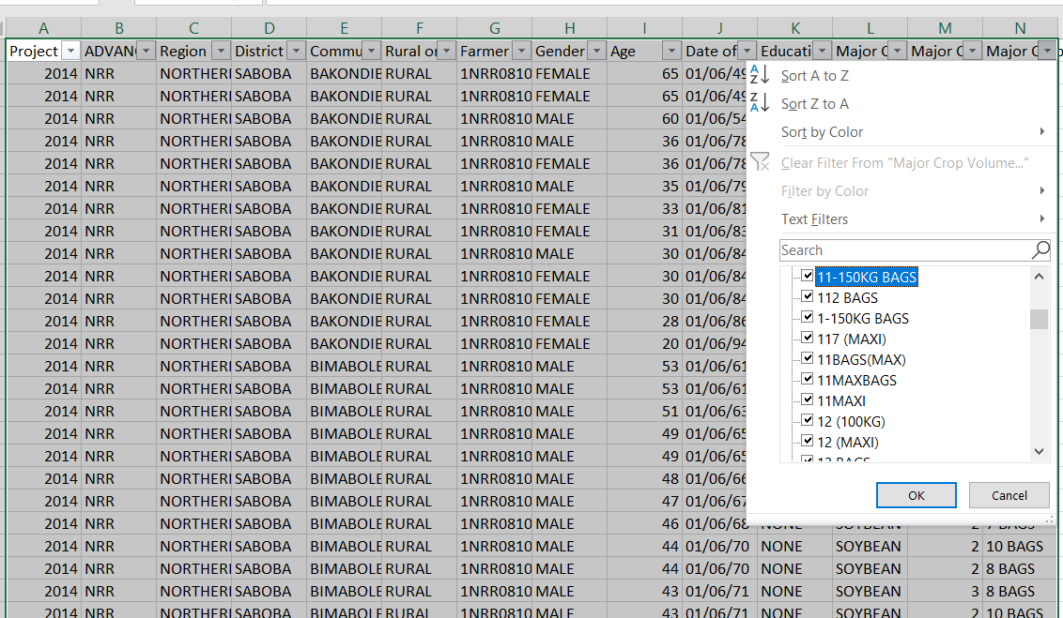
Data cleaning
Sorry, sorry, sorry, I meant
THIS dataset. okThanksBye

Slide 3
Cleaning in Excel problems
Steps not documented
Mistakes tough to find
Cleaning and analysis steps have to be redone every time
Data and analysis combined
Sooooo much more
See: http://www.acdivoca.org/2017/11/3873/
Is there another way?

Slide 4
Reproduceable research!
“Can do all the steps again”
How to do it?
Options?
Excel: Yes… through VBA macros, but VERY difficult.
Power BI: … getting better, but kind of limited and kind of difficult
SPSS/SAS: Yes, but difficult and $$$$$$$$$$$$
Better way?
Raw Data
Clean
Processed Data
Process
Analysis output

Slide 5


Slide 6
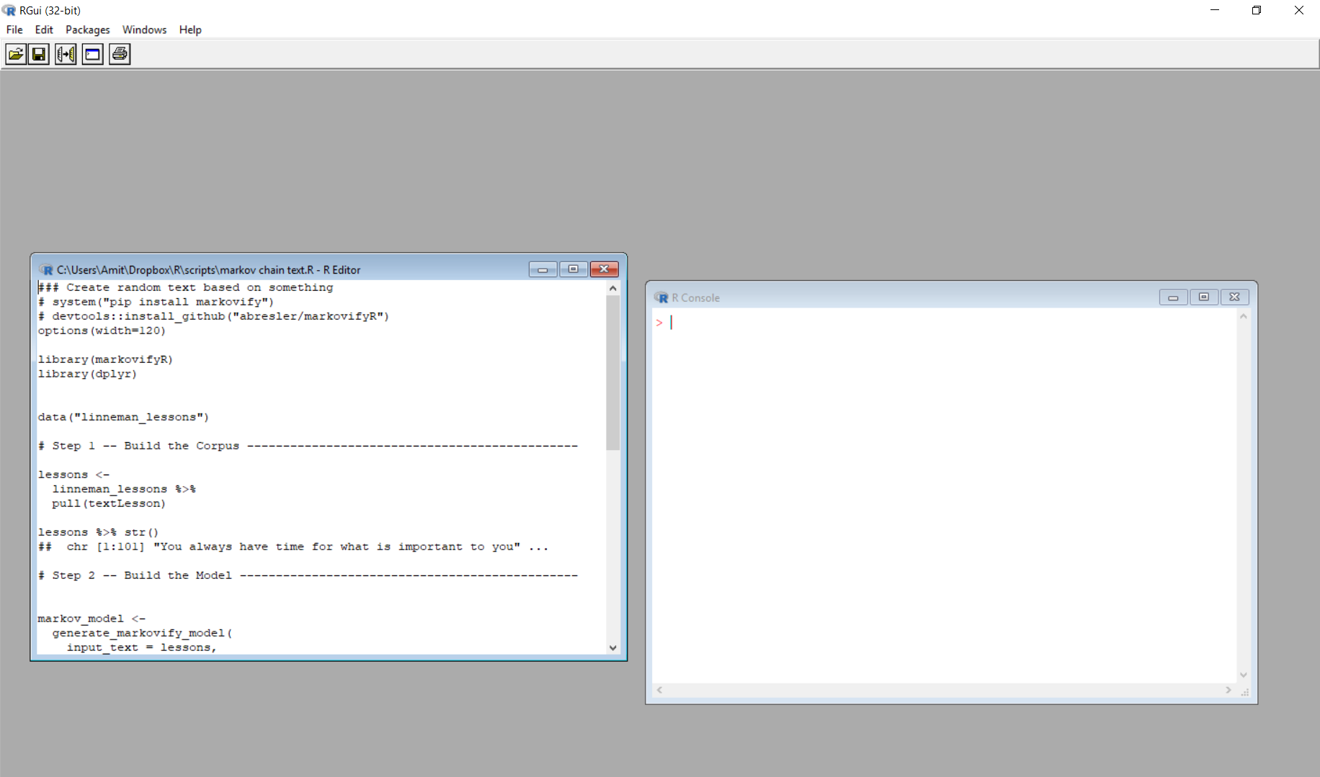
How does it work?
(save these like normal files)
CONSOLE
SCRIPT FILE
This executes everything!

Slide 7
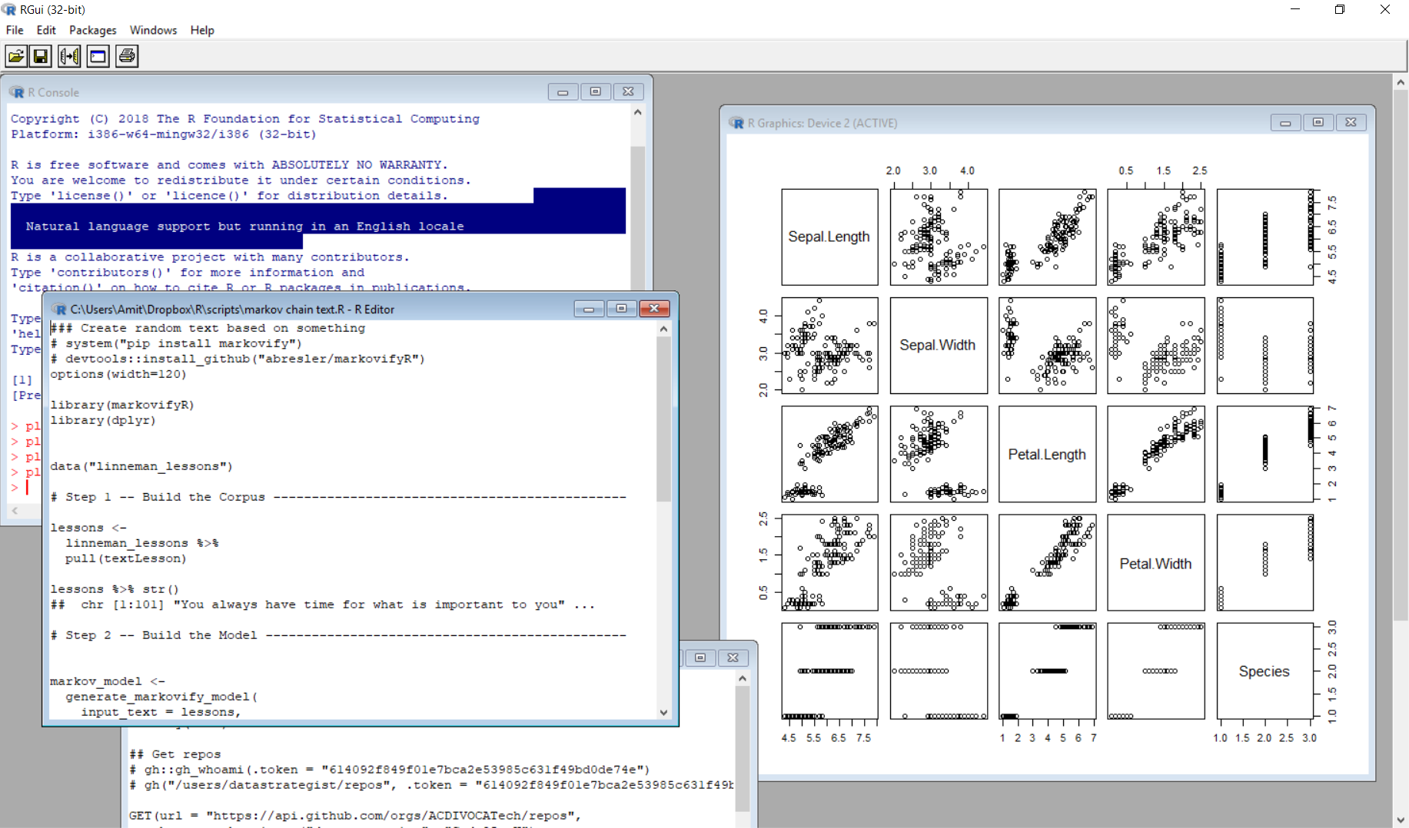
R interface uncomfortable :-/
No easy way to see your stuff
One plot at a time
No autocomplete
Messy console vs script files

Slide 8
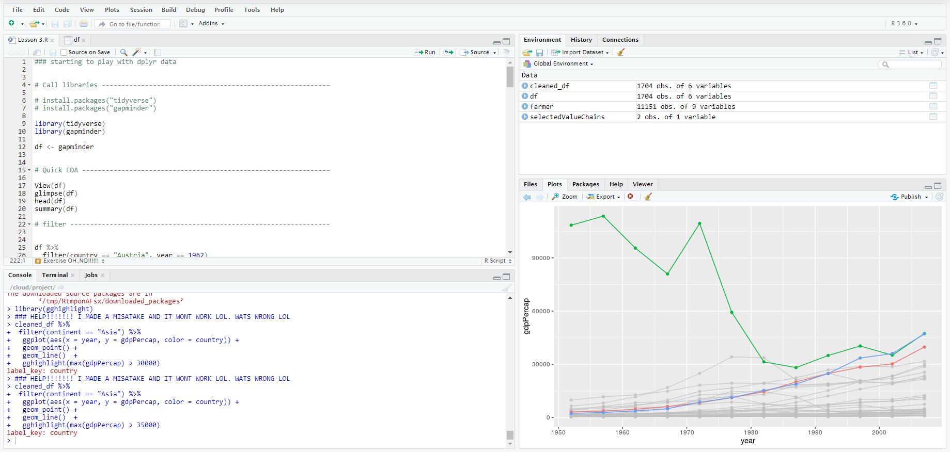
Rstudio ❤
Many scripts and pretty table views
My data and stuff
Console
File viewer & all my plots

Slide 9
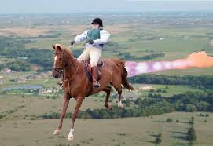




R vs Rstudio
Rstudio
R

Slide 10

Thought point
Can Rstudio run without R?

Slide 11
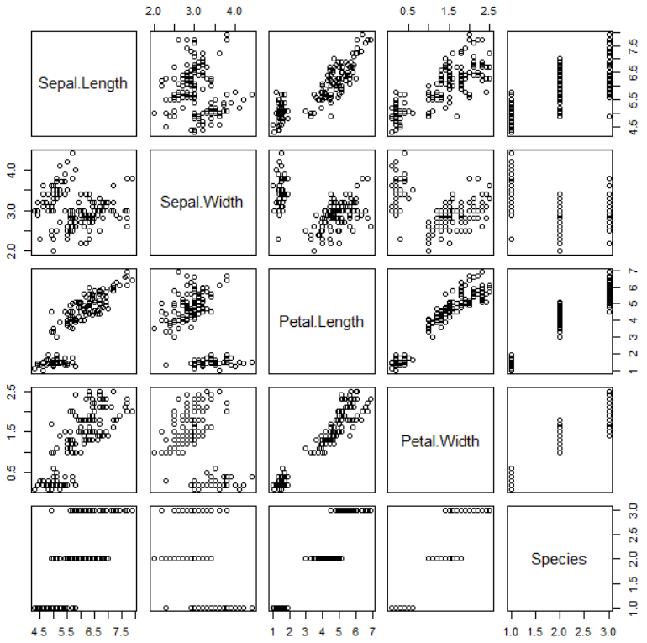
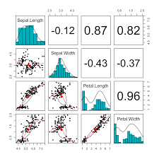
What are libraries?
Collections of functions that help us do something specific.
Do one thing and do it well!
<- “Base” R
Special
package ->

Slide 12


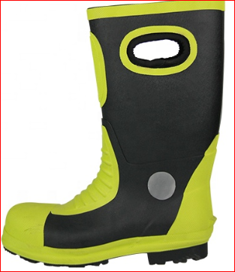


What are libraries?
R

Slide 13
Thought point
Why libraries? Why not have one program that can do everything?

Slide 14
On libraries
Over 15 000 on CRAN!
Many times that number on other sources
PROS
CONS
Probably a package for
everything you want
Anyone can author a library
Inconsistency :-/

Slide 15

Enter the tidyverse!
The tidyverse is an opinionated collection of R packages designed for data science. All packages share an underlying design philosophy, grammar, and data structures.
Source: https://www.tidyverse.org/

Slide 16
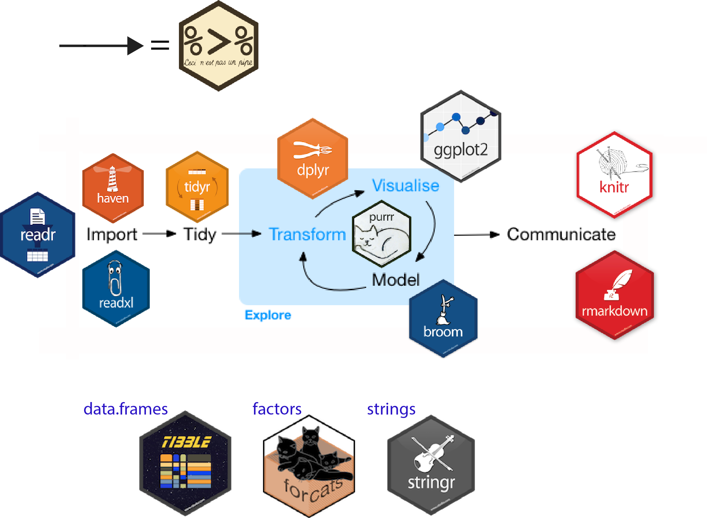
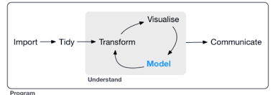
Basic tidyverse premise

Slide 17
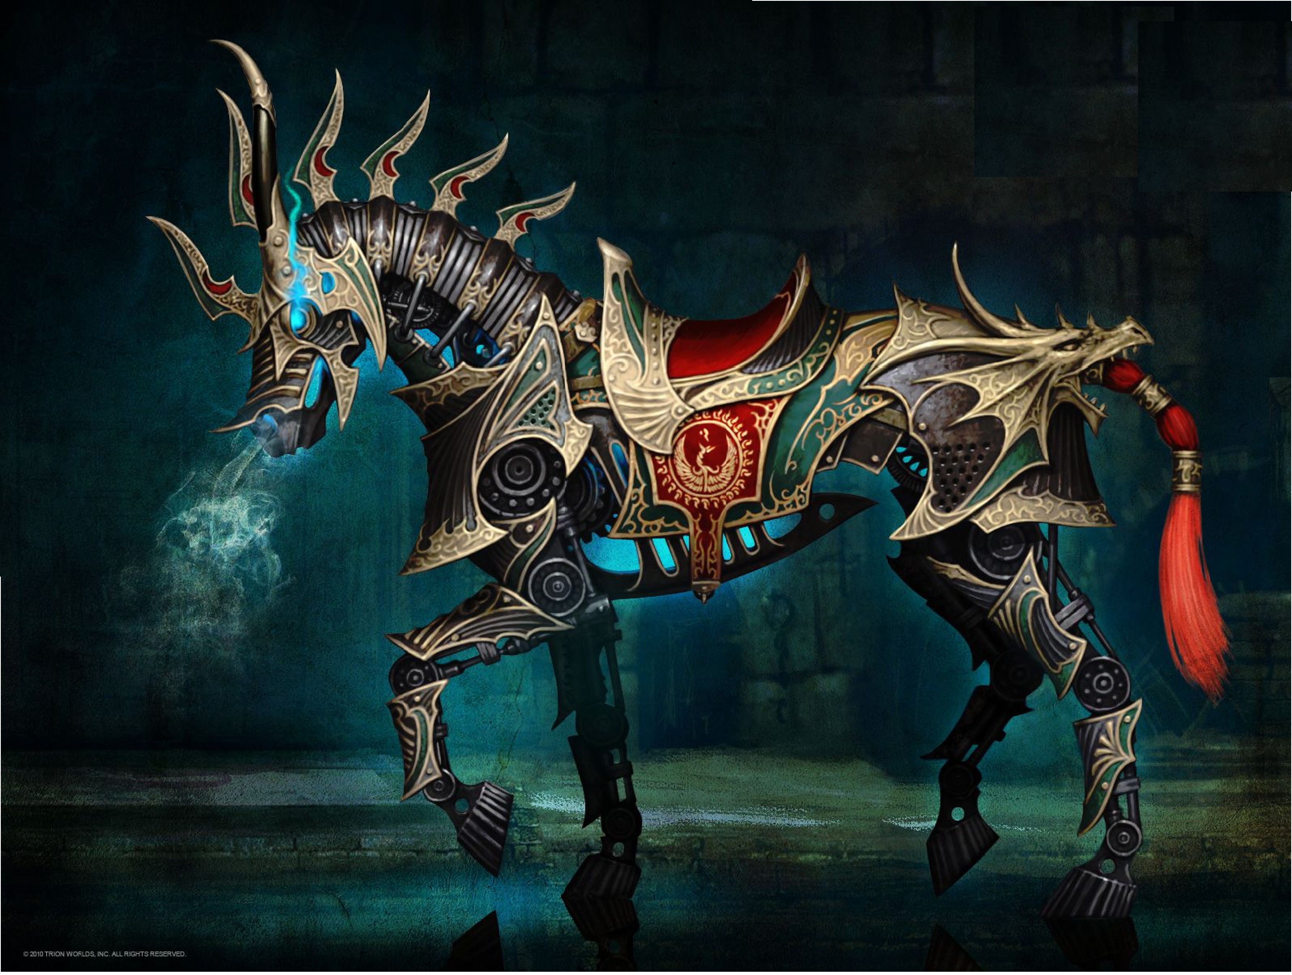
R + Rstudio + Tidyverse

Slide 18
Thought point
Describe a workflow you do using the tidyverse principles.

Slide 19





A few notes about how to use R
thingie <- function(input1, input2)
Cake <- bake( flour , sugar , eggs)
french_fries <- fry(temperature = 300, ingredient= potato )
object
function
value
value

Slide 20
Terminology quiz
Which of these are numbers?
1 "1" "one“ one
Strings (text)
object

Slide 21


Slide 22
What we learned
Theory:
R
Rstudio
Tidyverse
libraries
functions
Practice:
Read in csv file
Light processing
Light plotting with ggplot2

